Slide 1

Bitcoin price prediction using machine learning: An approach to sample dimension engineering
Name of the Supervisor :
Dr.R.Raja (Assoc.Prof)
Team Members :
Vadlakonda kavya (21B81A6780)
Sania (21B81A67B3)
Vaishnavi Chinnala (21B81A67C2)

Slide 2
Domain Introduction
Cryptocurrencies and Bitcoin : Cryptocurrencies, such as Bitcoin, have experienced significant price fluctuations in recent years, making them an intriguing investment asset. Understanding and predicting Bitcoin prices is crucial for investors and traders.
Machine Learning in Finance : The application of machine learning techniques has shown promising results in various financial domains, including asset price prediction. Leveraging machine learning for Bitcoin price prediction is an active area of research.

Slide 3
Challenges and Problem Statement
Challenges
Accurately predicting Bitcoin prices is a challenging task due to the high volatility and complex dynamics of the cryptocurrency market. Existing studies have primarily focused on improving prediction accuracy, but the impact of sample dimension on model performance has been overlooked.
Problem Statement
This study aims to investigate the feasibility of applying different machine learning techniques to Bitcoin price prediction, while also examining the importance of sample dimension engineering. The goal is to develop a more robust and effective approach to Bitcoin price prediction.

Slide 4
Existing Methodologies
1)Logistic Regression (LR) : Statistical method for binary classification. Used for daily Bitcoin price prediction with high-dimensional features.
2)Linear Discriminant Analysis (LDA) : Technique for dimensionality reduction and classification. Effective for linear separability in high-dimensional spaces.
3)Random Forest (RF) : Ensemble learning method using decision trees. Known for handling large datasets with higher accuracy.
4)Support Vector Machine (SVM) : Supervised learning model for classification tasks. Utilizes hyperplanes for optimal separation between classes.
5)Long Short-Term Memory (LSTM) : Type of recurrent neural network (RNN). Effective for sequential data and time series prediction.

Slide 5
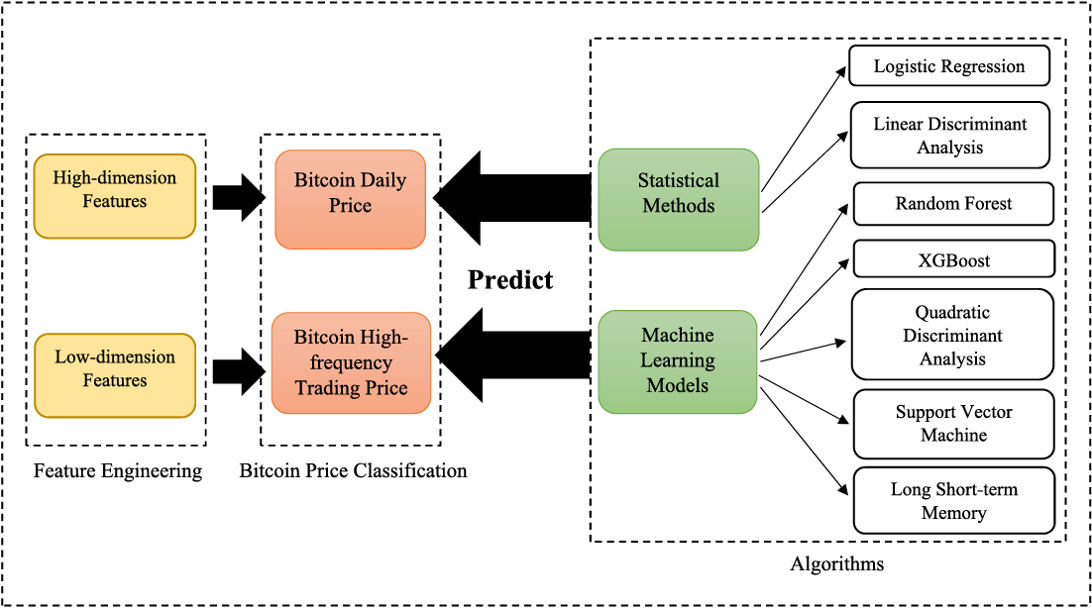
Proposed Methodologies:
Bitcoin Price Granularity
This study classifies Bitcoin price data into two categories: daily price and high-frequency (5-minute interval) price. This allows for the investigation of the impact of sample dimension on model performance.
Feature Engineering
For daily price prediction, a set of high-dimensional features, including property and network, trading and market, attention, and gold spot price, are utilized. For 5-minute interval price prediction, basic trading features acquired from a cryptocurrency exchange are employed.
Modeling Techniques
The study will leverage both statistical methods (LR and LDA) and machine learning models (RF, XGBoost, QDA, SVM, and LSTM) for Bitcoin price prediction at different frequencies. The comparative analysis will shed light on the impact of sample dimension on model performance.
Binary Classification
Instead of predicting the exact Bitcoin price, this study will develop a binary classification algorithm to predict the sign change of Bitcoin price, which can be more useful for traders and investors to make decisions.

Slide 6
Proposed Modules :
Data Collection and Preprocessing :
Aggregate Bitcoin daily prices from CoinMarketCap. Collect 5-minute interval trading data from Binance.
Feature Engineering: Identify key features :
Hash rate, block size, market capitalization, Google Trends. Implement Boruta and forward/backward stepwise selection for feature importance.
Model Development :
Apply LR and LDA for daily price predictions. Use RF, XGBoost, QDA, SVM, and LSTM for high-frequency price prediction.
Evaluation and Optimization :
Compare model performance using accuracy, precision, recall, and F1-score. Optimize models based on training and testing datasets.

Slide 7
System Architecture :
1) Data Collection : Gather Bitcoin price data at different frequencies, along with relevant feature data, from various sources.
2) Data Preprocessing : Clean and preprocess the data, handling missing values and outliers, and transforming the data as needed for the machine learning models.
3) Feature Engineering : Engineer relevant features for both daily and high-frequency Bitcoin price prediction, based on domain knowledge and data exploration.
4) Model Training and Evaluation : Train and evaluate the performance of the statistical and machine learning models for Bitcoin price prediction at different frequencies.
5) Model Deployment : Deploy the best-performing model for real-world Bitcoin price prediction and decision-making support.

Slide 8
Experimental Results :
Prediction Accuracy : The machine learning models, such as Random Forest and XGBoost, outperformed the statistical methods (Logistic Regression and Linear Discriminant Analysis) in terms of prediction accuracy for both daily and high-frequency Bitcoin price prediction.
Impact of Sample Dimension : The study found that the performance of the machine learning models was significantly influenced by the sample dimension. Models trained on high-frequency (5-minute) data exhibited higher accuracy compared to those trained on daily data.
Binary Classification : The binary classification algorithm developed in this study was able to effectively predict the sign change of Bitcoin prices, providing a more actionable and useful output for traders and investors.
Future Work : Ongoing research aims to further investigate the influence of sample dimension on model performance, explore ensemble techniques, and incorporate additional feature engineering to enhance the accuracy and robustness of Bitcoin price prediction.

Slide 9
References :
Nakamoto, S. (2008). Bitcoin: A peer-to-peer electronic cash system. Decentralized Business Review, 21260.
Lahmiri, S., & Bekiros, S. (2019). Cryptocurrency forecasting with deep learning chaotic neural networks. Chaos, Solitons & Fractals, 118, 35-40.
Jiang, Z., & Liang, J. (2017). Cryptocurrency portfolio management with deep reinforcement learning. In 2017 Intelligent Systems Conference (IntelliSys) (pp. 905-913). IEEE.
Qiu, J., Wang, B., & Zhou, C. (2020). Forecasting stock prices with long-short term memory neural network based on attention mechanism. PloS one, 15(1), e0227222.
Huang, W., Nakamori, Y., & Wang, S. Y. (2005). Forecasting stock market movement direction with support vector machine. Computers & Operations Research, 32(10), 2513-2522.

